Slide 1

Deep Graph Library an update
https:www.dgl.ai
Zheng Zhang
Director, AWS Shanghai AI Lab (zhaz@amazon.com)
zz@nyu.edu (on leave)

Slide 2
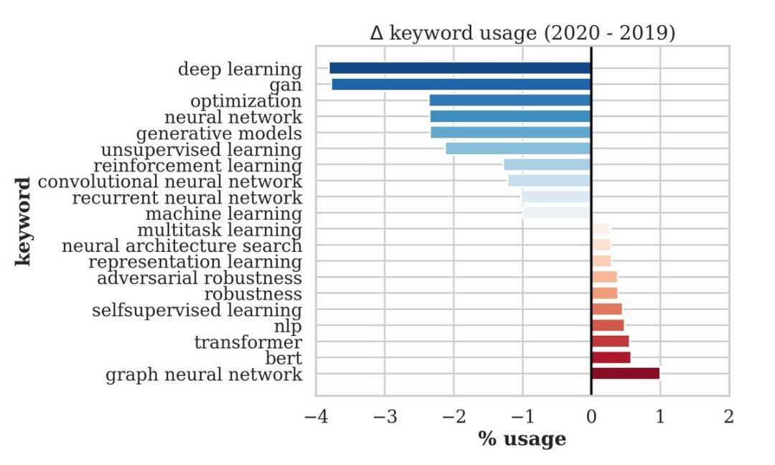
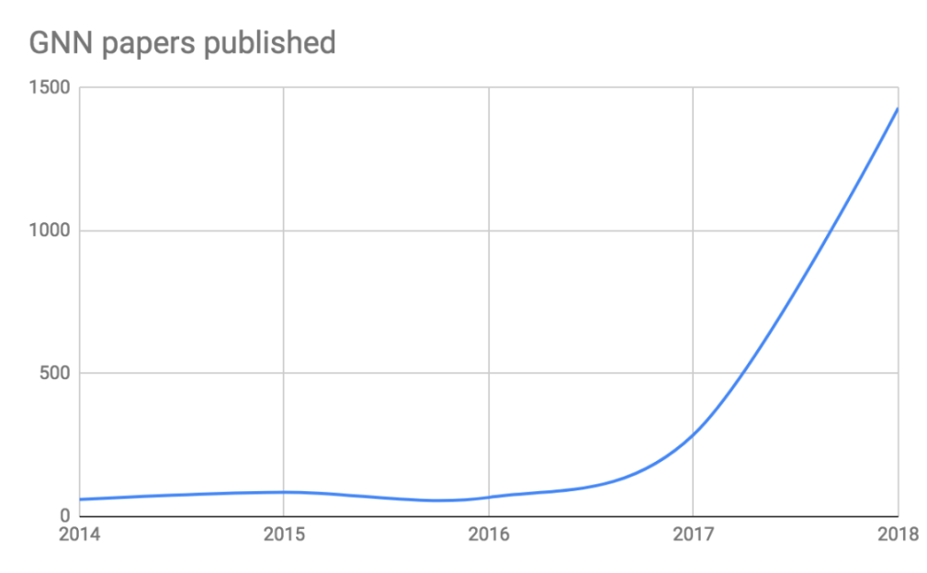
Deep learning + Graph

Slide 3
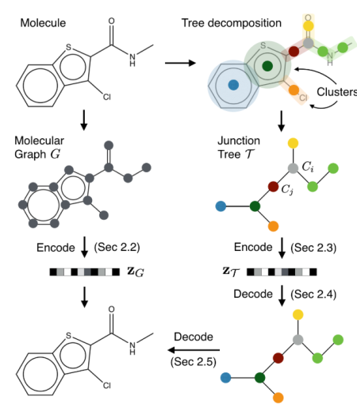
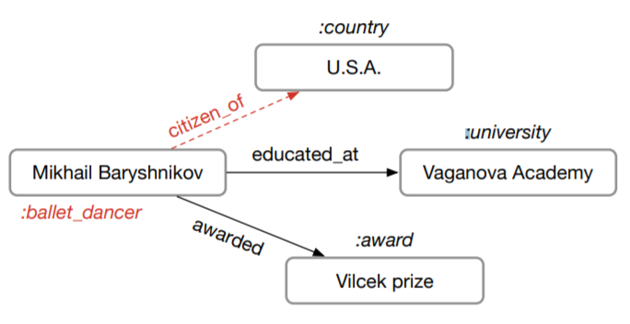
DNN Trend: deep learning on graphs
users
products
Molecule Graph
[Jin et al. ICML’18]
Knowledge Graph
[Schlichtkrull et al. arxiv’17]
Recommendation
[van den Berg et al. arxiv’17]
|V|: 100 – 1000
|V|: 1M – 100M
|V|: 1M – 1000M

Slide 4

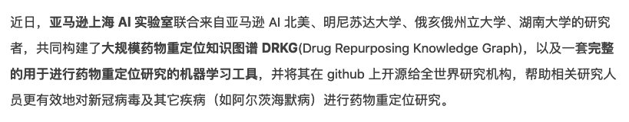
Drug-Repurposing KG (DRKG)

Slide 5
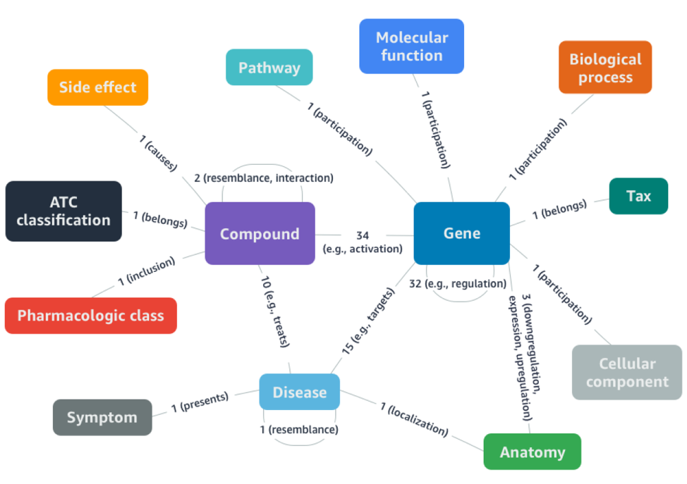
Drug-Repurposing KG (DRKG)
100K entities of 13 types
6M edges of 100+ types
Find “similar” compounds that target “similar” disease
11 of top-41 are under clinical trials for Covid-19
Completely open source
https://github.com/gnn4dr/DRKG

Slide 6

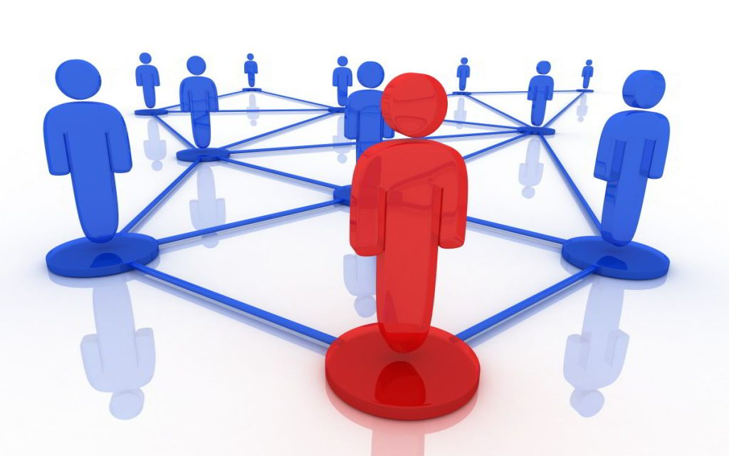
Deep Graph in a nutshell: “Who are you?”
Your DNA
… and your interactions to other DNAs

Slide 7
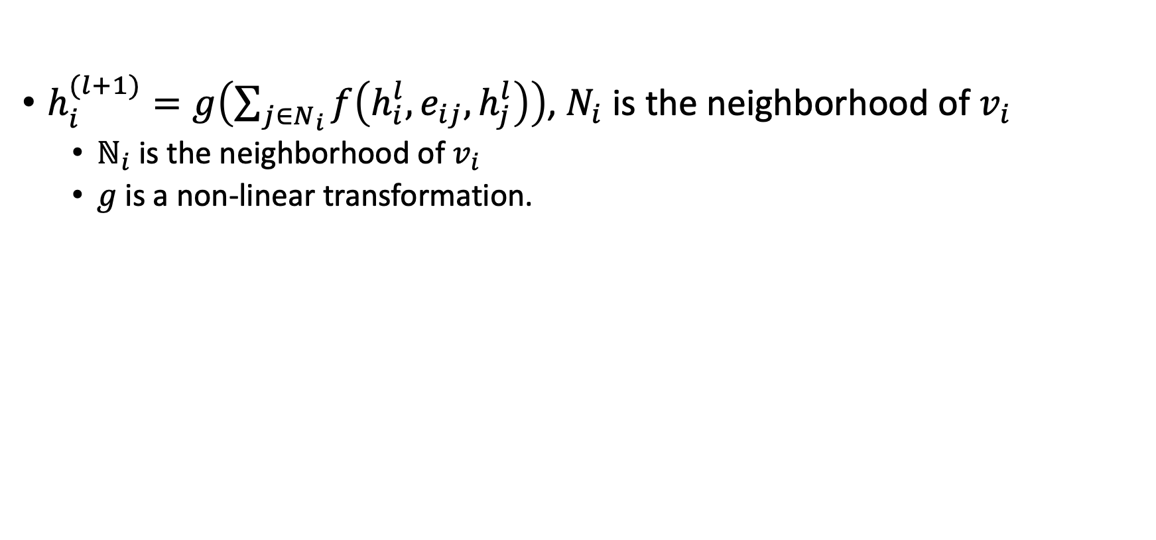
Formalization of graph neural networks
$h_{i}^{(l+1)}=g\left(\sum_{j∈N_{i}}{f\left(h_{i}^{l}, e_{ij},h_{j}^{l}\right)}\right)$, $N_{i}$ is the neighborhood of $v_{i}$
$ℕ_{i}$ is the neighborhood of $v_{i}$
$g$ is a non-linear transformation.

Slide 8
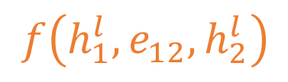
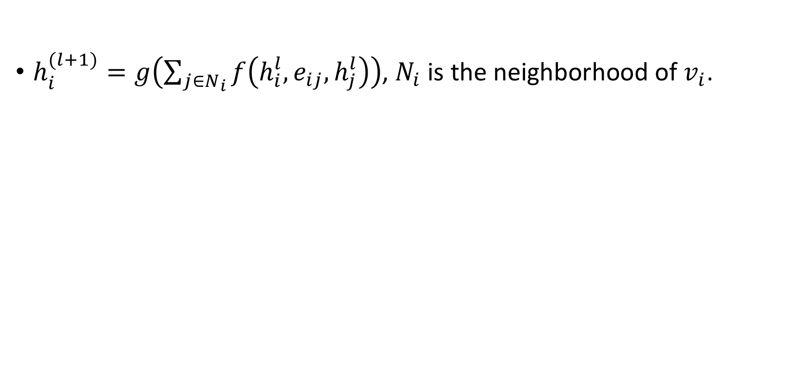
Formalization of graph neural networks
$h_{i}^{(l+1)}=g\left(\sum_{j∈N_{i}}{f\left(h_{i}^{l}, e_{ij},h_{j}^{l}\right)}\right)$, $N_{i}$ is the neighborhood of $v_{i}$.
$$f\left(h_{1}^{l}, e_{12},h_{2}^{l}\right)$$
m₁₂
2
3
1
5
4

Slide 9
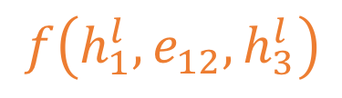
Formalization of graph neural networks
$h_{i}^{(l+1)}=g\left(\sum_{j∈N_{i}}{f\left(h_{i}^{l}, e_{ij},h_{j}^{l}\right)}\right)$, $N_{i}$ is the neighborhood of $v_{i}$.
m₁₂
m₁₂
2
3
$$f\left(h_{1}^{l}, e_{12},h_{3}^{l}\right)$$
1
5
4

Slide 10
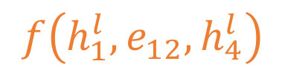
Formalization of graph neural networks
$h_{i}^{(l+1)}=g\left(\sum_{j∈N_{i}}{f\left(h_{i}^{l}, e_{ij},h_{j}^{l}\right)}\right)$, $N_{i}$ is the neighborhood of $v_{i}$.
m₁₂
m₁₃
m₁₄
2
3
1
$$f\left(h_{1}^{l}, e_{12},h_{4}^{l}\right)$$
5
4

Slide 11
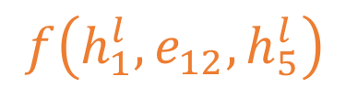
Formalization of graph neural networks
$h_{i}^{(l+1)}=g\left(\sum_{j∈N_{i}}{f\left(h_{i}^{l}, e_{ij},h_{j}^{l}\right)}\right)$, $N_{i}$ is the neighborhood of $v_{i}$.
m₁₂
m₁₃
m₁₄
m₁₅
2
3
$$f\left(h_{1}^{l}, e_{12},h_{5}^{l}\right)$$
1
5
4

Slide 12

Formalization of graph neural networks
$h_{i}^{(l+1)}=g\left(\sum_{j∈N_{i}}{f\left(h_{i}^{l}, e_{ij},h_{j}^{l}\right)}\right)$, $N_{i}$ is the neighborhood of $v_{i}$.
m₁₂
m₁₃
m₁₄
m₁₅
2
3
$$∑$$
1
s
5
g()
4
h

Slide 13
DGL: history, design & performance

Slide 14
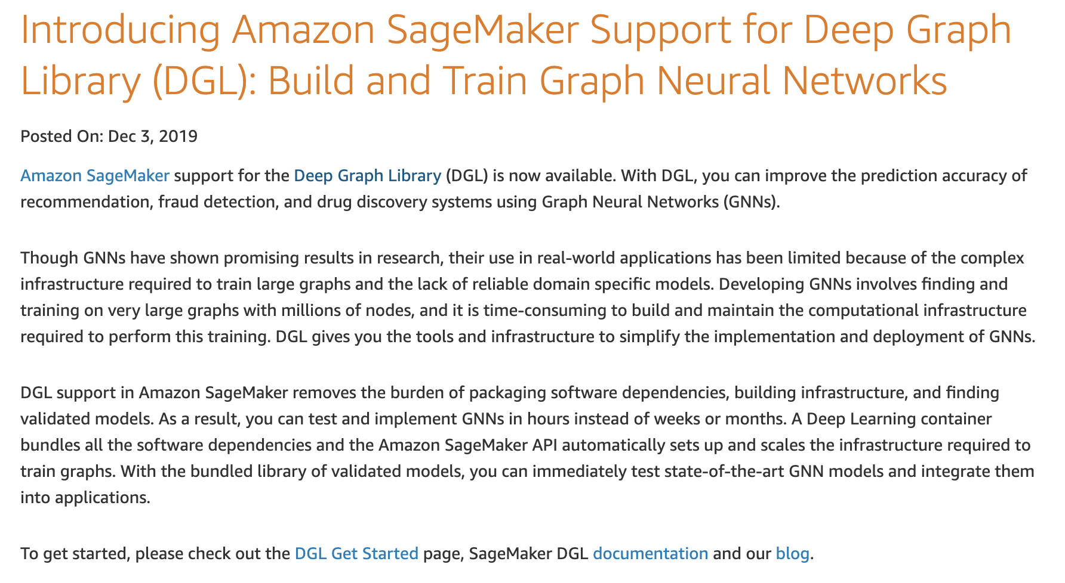
DGL: The history
V0.43
TF support
DGL-KE/DGL-LifeScie
Sampling
V0.3.1
NN modules
DGL-Chem
Development started
V0.2
Sampling APIs
2018
2019
2020
V0.3
Fused message passing
Multi-GPU/-core
First prototype
V0.1
(NeurIPS’18)
V0.4
Heterogeneous graph
DGL-KE (preview)

Slide 15
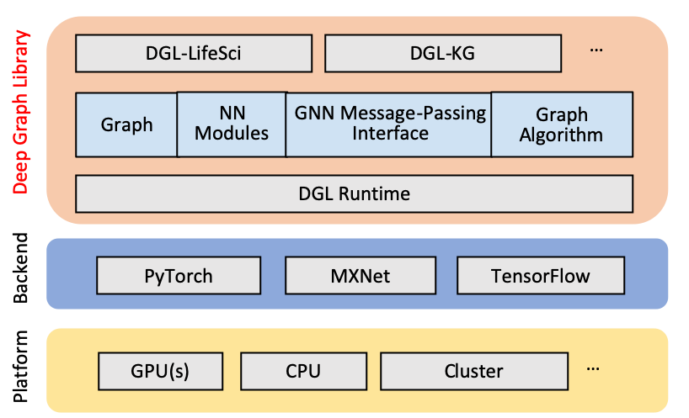
DGL meta-objectives & architecture
Forward and backward compatible
Forward: easy to build new models
Backward: framework neutral
Fast and Scalable

Slide 16
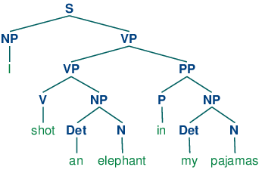
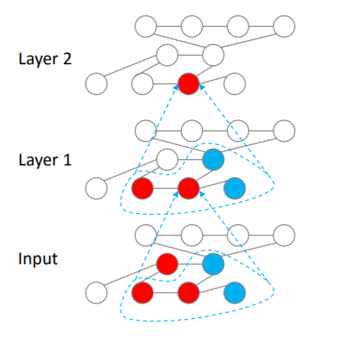
Flexible message propagation
Full propagation (“everyone shouts to everyone near you”)
Propagation by graph traversal
Topological order on sentence parsing tree
Belief propagation order
Sampling
Propagation by random walk

Slide 17
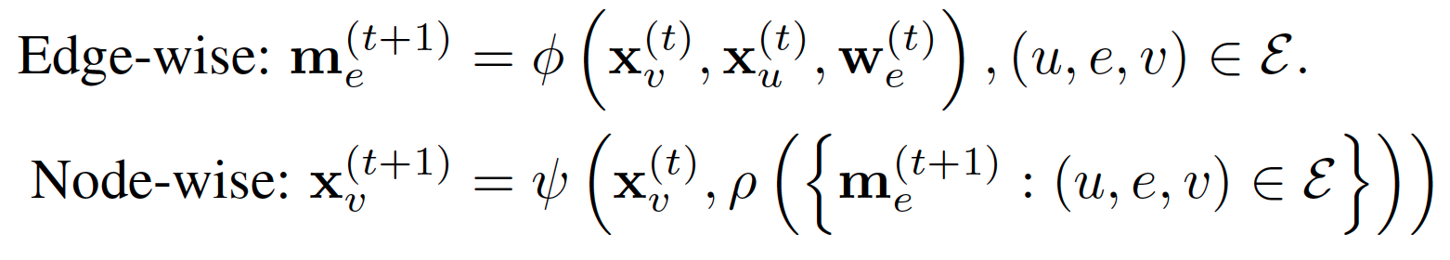
Flexible message handling
Message function
Update function
Reduce function
[Gilmer 2017, Wang 2017, Battaglia 2018]

Slide 18
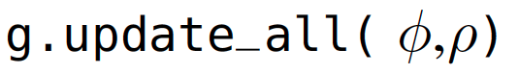
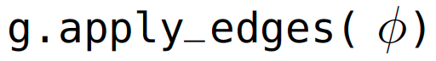
DGL programming interface
Graph as the core abstraction
DGLGraph
g.ndata[‘h’]
Simple but versatile message passing APIs

Slide 19
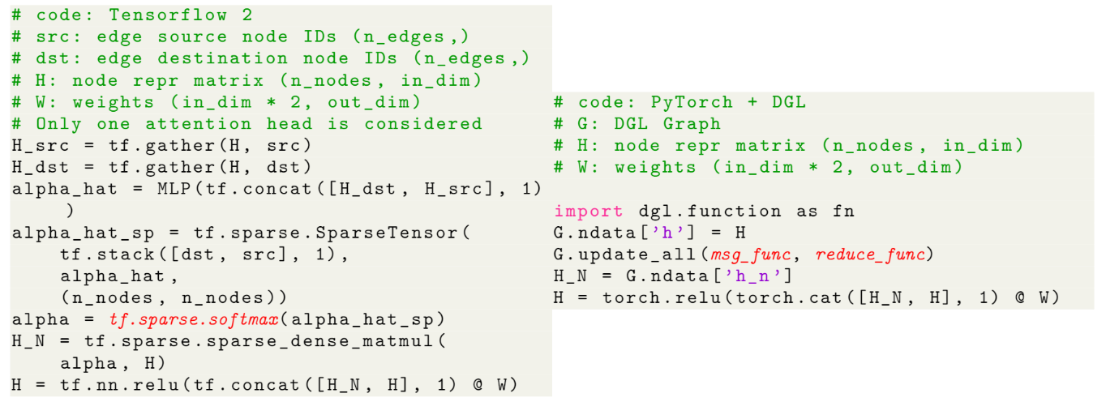
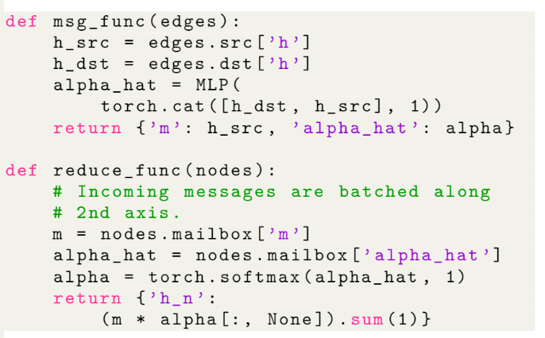
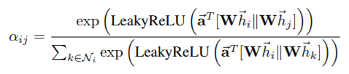
Writing GNNs is intuitive in DGL (GAT)

Slide 20
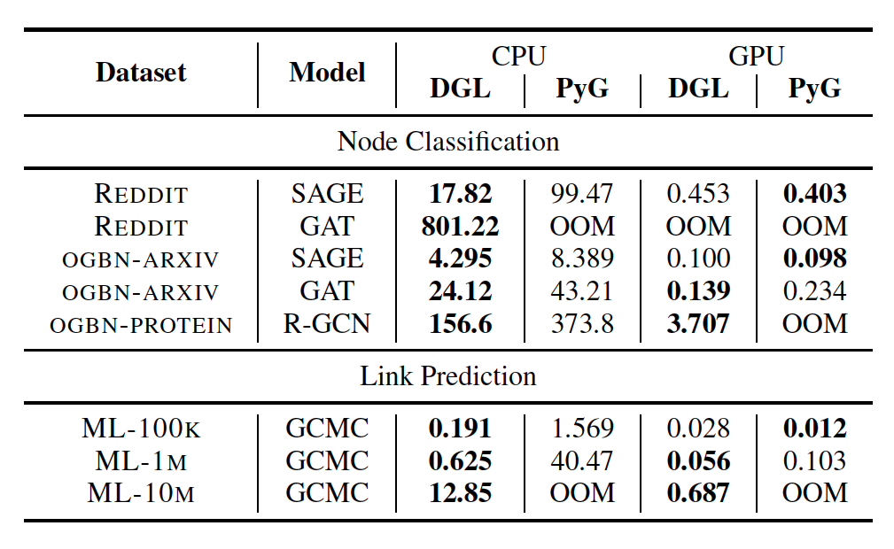
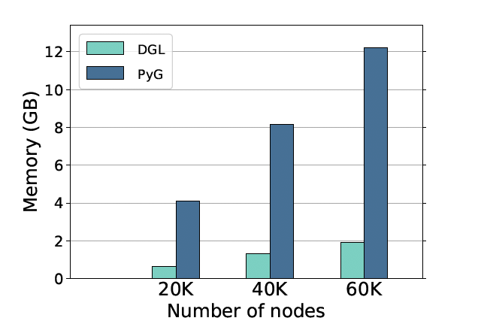
Performance
GAT on synthetic dataset

Slide 21
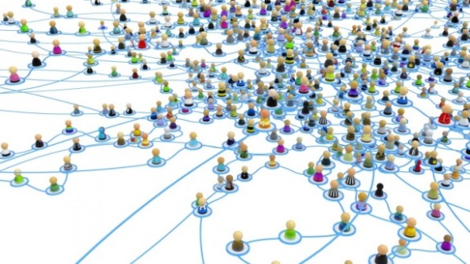
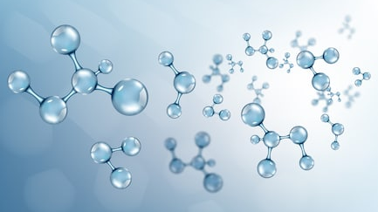
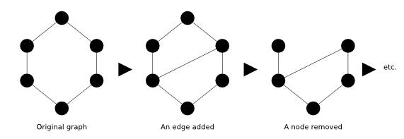
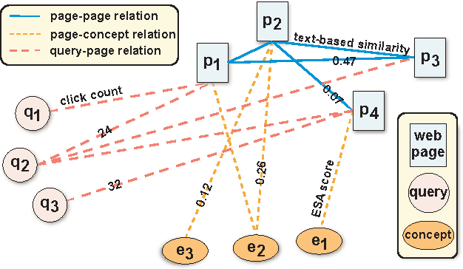
Different scenarios require different supports
Sampling
Batching graphs
Single giant graph
Many moderate-sized graphs
Mutation
Heterogeneous
Dynamic graph
Heterogeneous graph
Notes:
Another design consideration is that graphs in different scenarios require different supports
Community detection: system needs to be memory efficient, and support random walk and graph sampling
Drug discovery, protein property prediction: batching is a high priority
The system should support graph mutation
For example, this graph here represents the interactions in a search engine. A task could be given a query, what is the page returned? This can be casted as a link prediction problem on this graph.

Slide 22
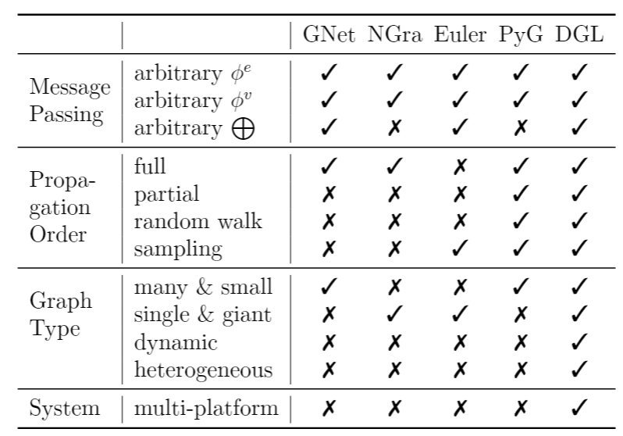
Summary of DGL Programming Interface
User-defined functions
Send, Recv
Active set
Batching APIs
Mutation APIs
Sampling APIs
Support multi-type

Slide 23
Achieving frame-neurality
Why?
An application of GNN takes a lot more than the GNN model it uses
Data loading, pre-processing, feature extractors….
DGL’s strategy:
Take control of the minimum and the critical (e.g. DGLGraph)
Leverage the rest from the framework: auto-grad, memory management, dense tensor ops,…, sparse tensor ops
ALL domain package should consider if they want to be real-world ready

Slide 24
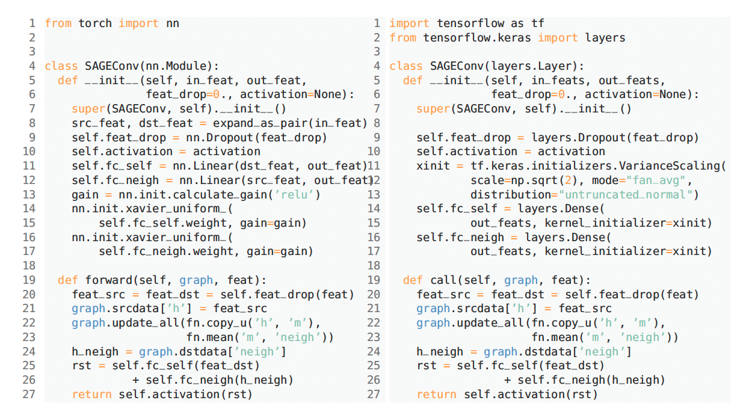
Achieving frame-neurality (not agnostic)

Slide 25
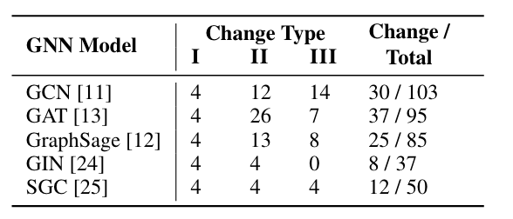
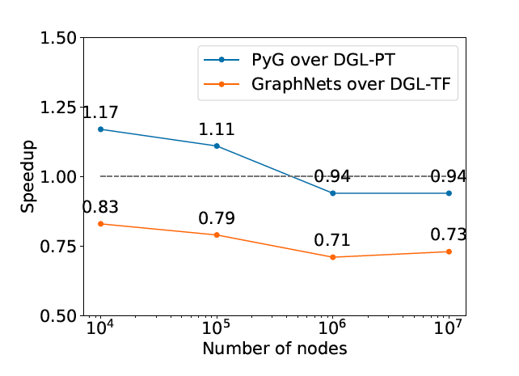
The cost of being framework-neutrality
Porting effort
Performance impact
Model class inheritance
Sub-modules and parameter initialization
Framework-specific operators

Slide 26
More applications
Discover
Leverage

Slide 27
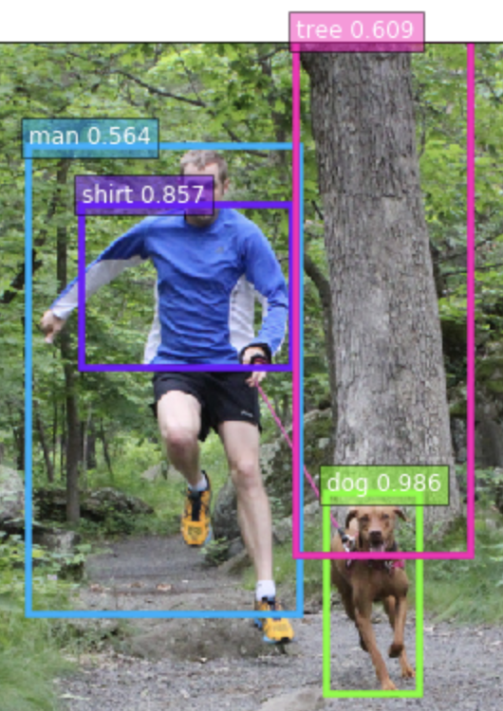
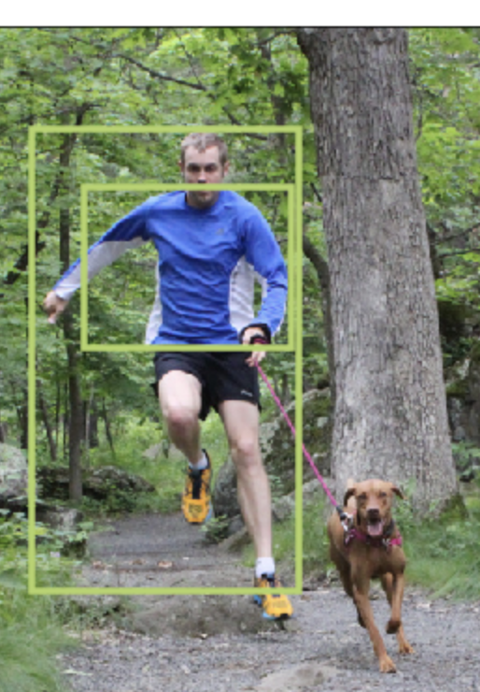
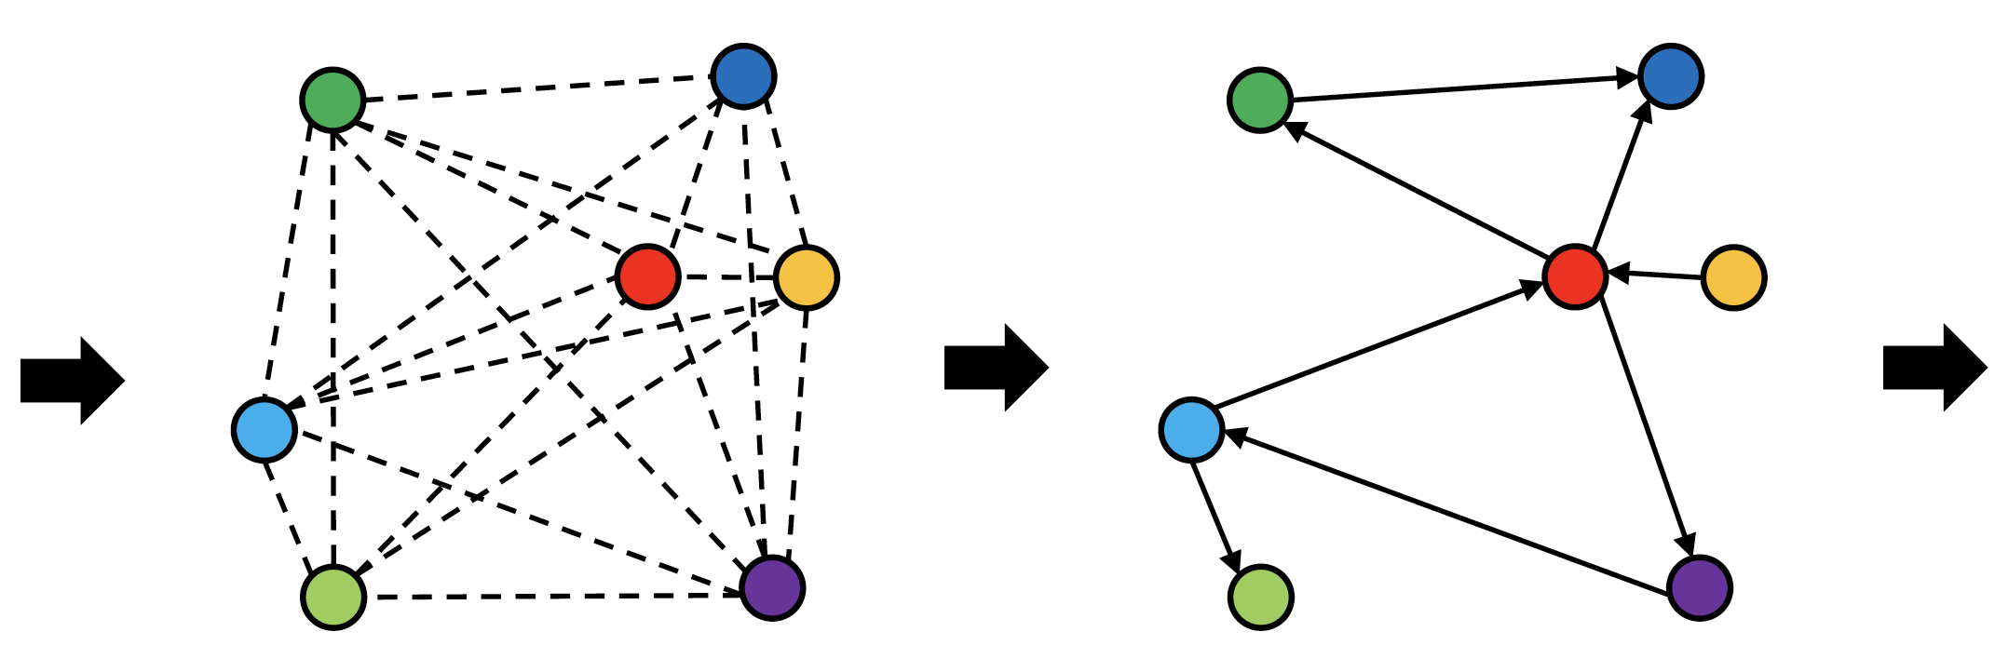
Scene graph extraction (experimental)
Graph R-CNN for Scene Graph Generation
Per epoch time 45min (vs. 2.5hr)
Link exists with prob 68.99%
Link type:
<man> <have> <shirt>, 43.29%
<man> <wear> <shirt>, 39.64%
GCN
Object Detection
Notes:
Our model can be trained in less than one hour as it converges to produce good results. This example also shows the possible ambiguity of relationships, and how the model deals with it.

Slide 28
Seeing the world from the lens of graphs
Small graphs produced every second (e.g. sentences and images)
log(# Graphs created/second)
Strong AI
Several giant graphs changes every second
(e.g. knowledge graph, social networks)
log(Graph size)

Slide 29
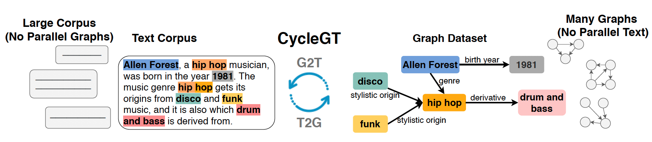
CycleGT: Unsupervised Graph-to-Text and Text-to-Graph Generation via Cycle Training
Formulate text-to-graph and graph-to-text as a dual problem
Cross-modality cycle consistency, fully unsupervised, unparallel (graph, text) pairs
Achieve comparative performance as fully supervised

Slide 30

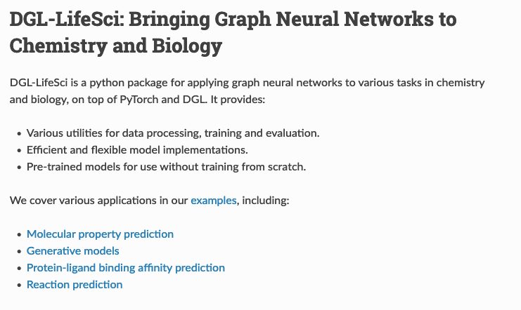
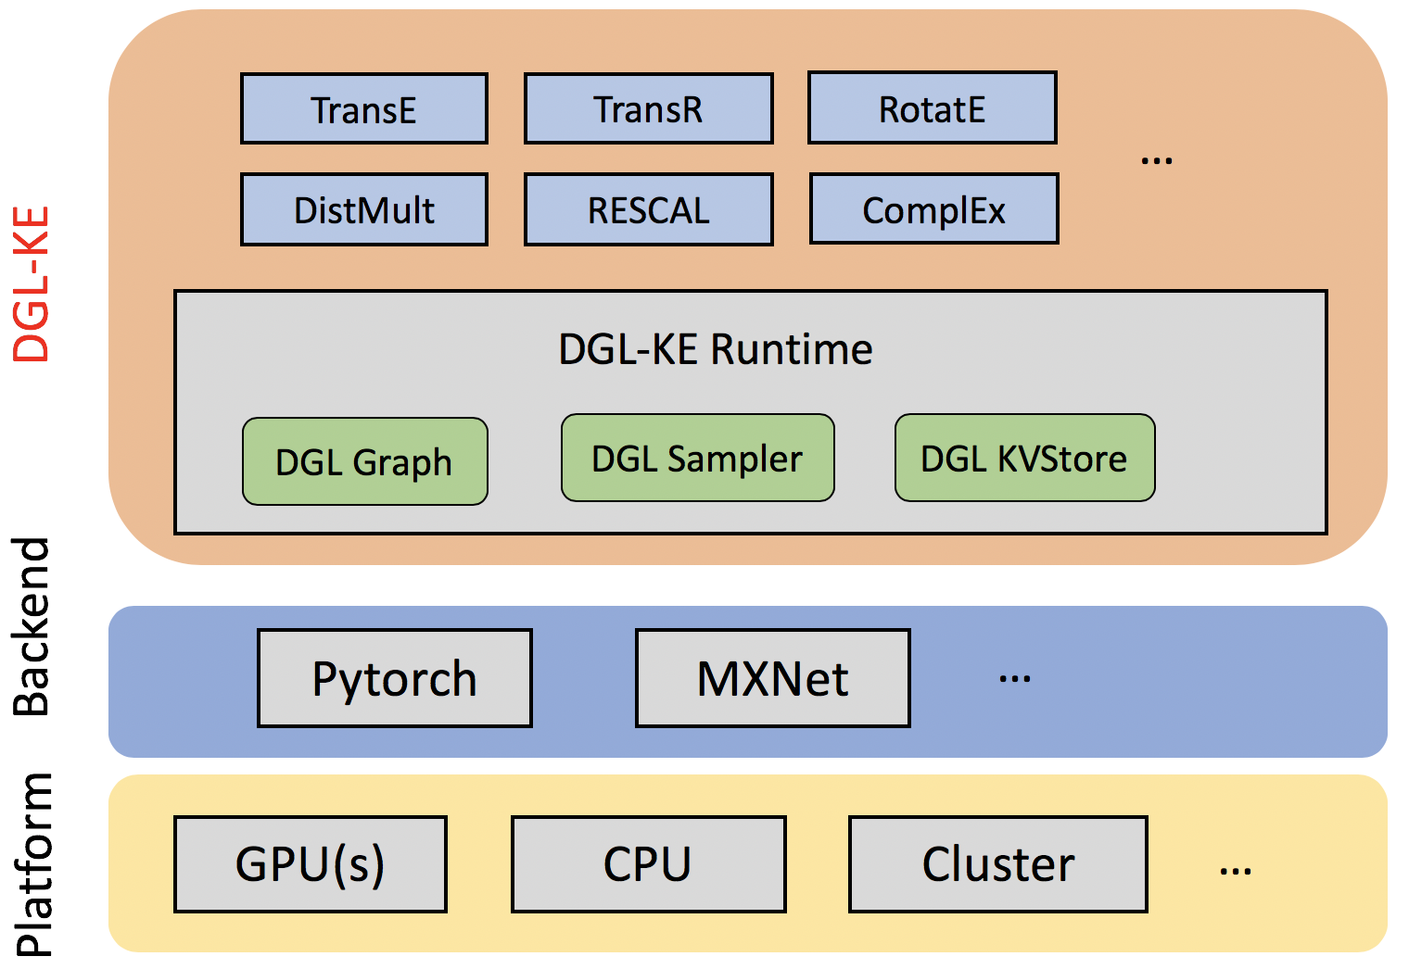
DGL-based domain packages
SOTA performance
Trains the full Freebase in 30min
(DRKG is an application of DGL-KE)
SOTA performance
2.5x ~ 13x faster than other packages

Slide 31
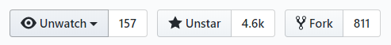
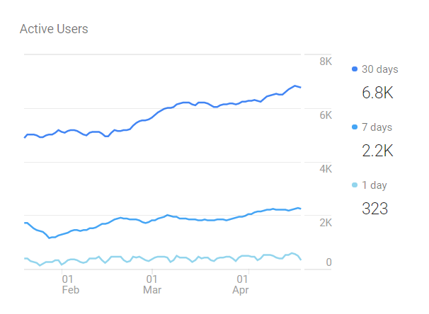
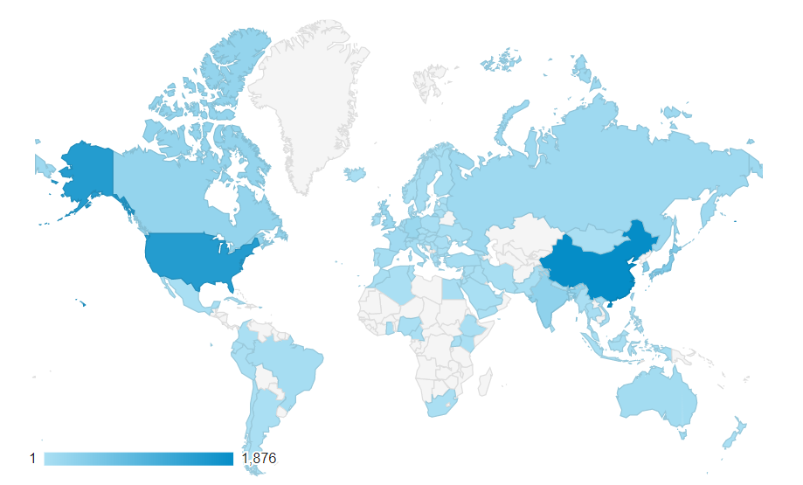
Open source, the source of innovation
Neurips’19
WWW’20
3481 4555 github stars 312k 1770k downloads for all versions on Pip 8.8K 13K downloads for all version on Conda 1.8K 6.4K anaconda downloads of 0.4+ | 32 model examples, 28 NN modules (including 14 15 GNN convolution modules) 6 10 pretrained models for chemistry GCN, generative, KG, RecSys… 45 53 contributors, 10 core developers

Slide 32
DGL: next step(s)
V0.3.1
NN modules
DGL-Chem
V0.43
TF support
DGL-KE/DGL-LifeScie
Sampling
Development started
V0.2
Sampling APIs
2018
2019
2020
V0.3
Fused message passing
Multi-GPU/-core
First prototype
V0.1
(NeurIPS’18)
V0.4
Heterogeneous graph
DGL-KE
V0.5
Distributed training

Slide 33
Reflection of Open-Source

Slide 34
Why OSS can be a win-win?
Deep Graph Researchers
Deep Graph Domain Scientists
dgl.ai
DGL domain packages
DGL core
DGl-KE
DGl-LifeSci
nn modules, models
Open Source
AWS proprietary
SageMaker
DGL-enhanced services
AWS/Amazon internal & external customers

Slide 35
OSS projects: pitalls and lessons
Re-invent the wheel without a good cause
Underestimate the investment effort
E.g. MinPy (“NumPy + AutoGrad on CPU/GPU”)
Forget documentation takes non-trivial time (~+20%)
Do not eat your own dogfood (a good model is the best promotion)
Evolve too fast, or too slow
Know your customers:
E.g. scale outside what they can affort
Fix: try Amazon Learship Principle #1: Customer Obsession (e.g. PyTorch -- “Put researchers first”)

Slide 36
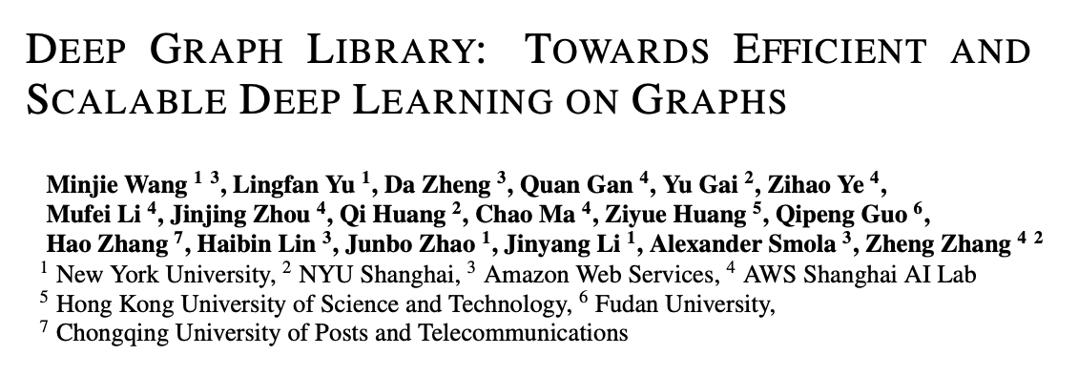
Q&A
Welcome contributions! Please cite:
Leverage
George Karypis (Univ Minnesota/AWS)
Discover
We are hiring!

